Slide 1


Institutional Presentation
April 2013

Slide 2
Disclaimer
This presentation contains statements that may constitute “forward-looking statements”, based on current opinions, expectations and projections about future events. Such statements are also based on assumptions and analysis made by Wilson, Sons and are subject to market conditions which are beyond the Company’s control.
Important factors which may lead to significant differences between real results and these forward-looking statements are: national and international economic conditions; technology; financial market conditions; uncertainties regarding results in the Company’s future operations, its plans, objectives, expectations, intentions; and other factors described in the section entitled "Risk Factors“, available in the Company’s Prospectus, filed with the Brazilian Securities and Exchange Commission (CVM).
The Company’s operating and financial results, as presented on the following slides, were prepared in conformity with International Financial Reporting Standards (IFRS), except as otherwise expressly indicated. An independent auditors’ review report is an integral part of the Company’s condensed consolidated financial statements.

Slide 3
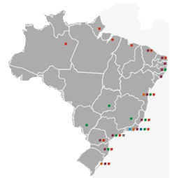
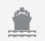
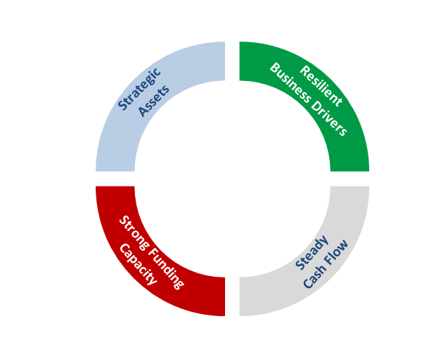
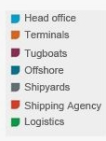

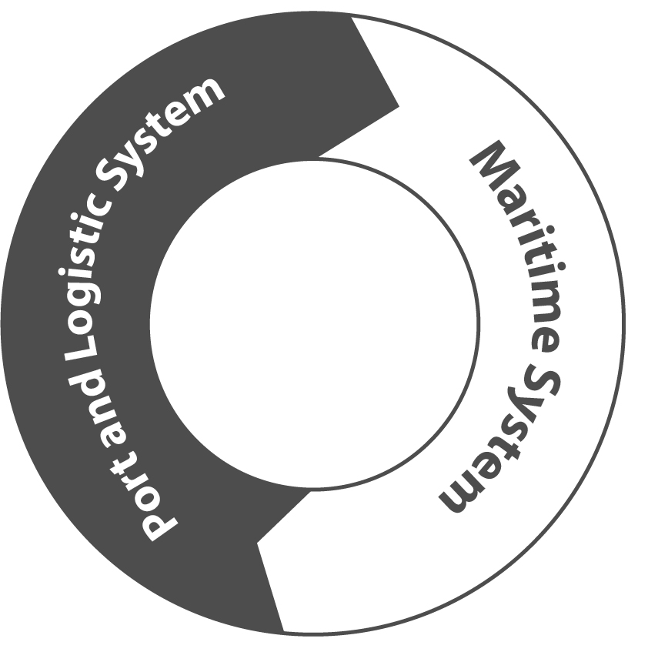
Wilson Sons at a Glance
International Trade Flow & Domestic Economy
Oil & Gas
Weighted Avg.
Cost of Debt
3.59% per year
151.5
121.4
122.7
2012
76.2
2010
2008
EBITDA
CAGR: 12%
As of Dec/2012
2006
*Fundo de Marinha Mercante
Strategic
Assets
Resilient
Business Drivers
Strong Funding
Capacity
Steady
Cash Flow

Slide 4
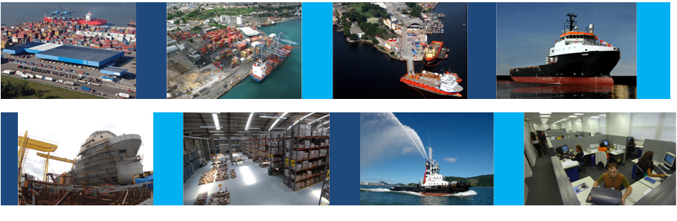
Our Growth Drivers

Slide 5


Oil & Gas: Very Positive Outlook
World Oil Reserves (Bn boe)
Source: BP Statistics Review 2012 + Government Forecasts
Brazilian Oil Production (M bpd)
Source: Petrobras + IOCs + OGX
Venezuela
296.5
6.7
Saudi Arabia
265.4
Iran
151.2
Iraq
143.1
3.5
CAGR
16%
Brazil (Est.)**
100.0
United Arab Em.
97.8
Upper estimate of potential growth of Brazilian oil reserves by 9 x
2.1
Russia
88.2
Brazil (Est.)*
50.0
Libya
47.1
2012
2015E
2020E
Brazil
15.1
* Probable oil reserves
** Possible oil reserves
Demand for Offshore Support Vessels (OSVs)
Source: ODS Petrodata + ABEAM / SYNDARMA + BTG Pactual
Increased Distances to new Oil Rigs
686
Average Campos Basin Distances
125 km
500
+ 272
414
Pre-salt Distances
300 km
2012
2015E
2020E

Slide 6
International Trade Flow & Domestic Economy: Brazil’s expansion
Brazil Exports + Imports (USD Bi)
Source: MDIC/Secex + Central Bank Estimates
Real GDP (USD Tri)
Source: PwC
CAGR 14.5%
2011
…
2050
CAGR
482
466
499
BRAZIL
2.3
8.8
3.5%
384
371
281
282
193
229
G7
30.7
70.6
2.2%
2005
2006
2007
2008
2009
2010
2011
2012
2013E
Imports
Exports
Upside Opportunity from Increased Efficiency
Source: World Bank
Increasing Container Handling in Brazil (#TEU M)
Source: ILOS
Export Procedures
Historical CAGR 6.4%
Estimated
CAGR 7.4%
Duration
(Days)
USD Cost
Duration
(Days)
USD Cost
Document Prepartion
6
325
2
230
13.5
15.6
10.2
11.7
Customs Clearance
3
400
1
60
7.0
6.8
8.2
8.8
5.0
6.2
Ports Handling
3
500
2
400
Inland Transort
1
990
1
400
Total
13
2,215
6
1,090

Slide 7
Our Business

Slide 8
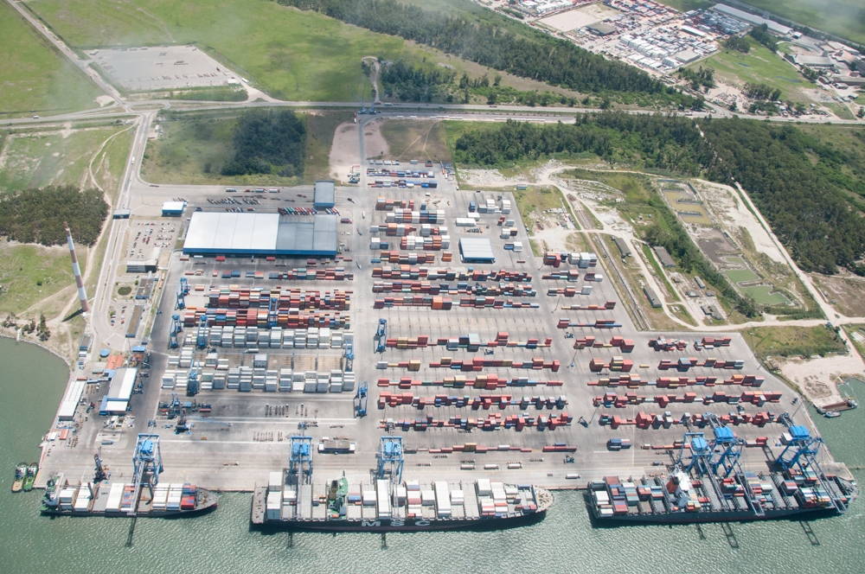
Container Terminals and Logistics
USD 189M
USD 108M
908,300
1,880,000
Cntr Terminals
Net Revenues
(29% of 2012 Total Revenues)
Logistics
Net Revenues
(17% of 2012 Total Revenues)
TEU handled
(2012 Tecon RG + Tecon SSA)
TEU capacity
(2012 Tecon RG + Tecon SSA)
Tecon Rio Grande

Slide 9
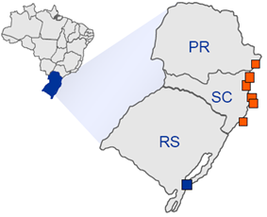
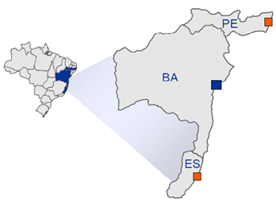
Container Terminals and Logistics
Container Terminal concessions for 25 + 25 years in the ports of Rio Grande and Salvador
Third largest container port operator in Brazil, with 11% market share
Strategically located assets are key competitive advantage
Tecon Rio Grande Location
Tecon Salvador Location
Tecon Suape (ICTS)
Paranaguá (Advent)
850 km
Itapoá (Hamburg Sud)
Tecon Salvador (Wilson Sons)
São Francisco do Sul (Dragados)
Itajaí / Navegantes (Maersk / MSC)
Imbituba (Santos Brasil)
1,182 km
688 km
Tecon Rio Grande (Wilson Sons)
TVV (Log-In)
Cntr Terminals Profile
Rio Grande
Salvador
Logistics: Focusing on EADI and Logistics Centres
Capacity
1,350k
530k
EADI Sto André
LC Itapevi
LC Suape
# Berths
3
2
Total Berth length (m)
900
617
Total Terminal Area (sqm)
92,000
21,800
49,000
Total area (sqm)
670,000
118,000
Total Covered Area (sqm)
33,800
15,800
23,000
Draft (m)
15
14
Distance to Port
72 km
108 km
1 km
# of STS (Portainers)
6
6

Slide 10
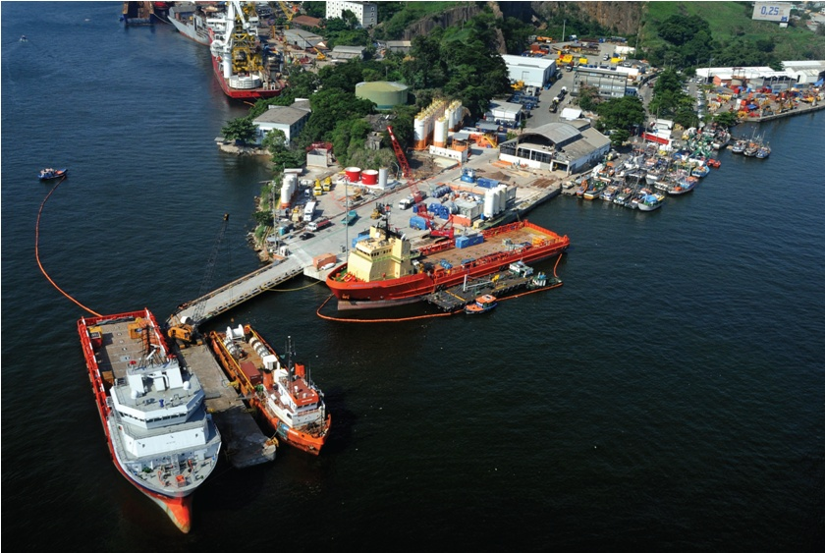
Port Terminals (Brasco)
USD 38M
1,002
~150,000
Net Revenues
(6% of 2012 Total Revenues)
Vessel Turnarounds (2012)
Operational base area (sqm)
Brasco (Niterói)

Slide 11





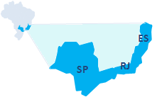



Port Terminals (Brasco)
Providing support to the Oil & Gas industry, combining own assets and expertise in public ports
First Oil & Gas private terminal operator in Brazil, with more than 10 years of experience
Strategically located bases across Brazil with advantageous access to the pre-salt areas
Main Services
Blocks by Operator: IOCs increasing position
Source: ANP
Upstream
~ 40 years according to specific areas
Load/Unload Cargo
Environmental Services
Exploration
Development
Production
Warehousing
Logistics Solutions
Strategic Location
Espírito Santo, Campos, and Santos Basins
Source: ANP
Espírito Santo
Basin
~ 91% of Oil & Gas production in Brazil
Brasco
Briclog
~ 100 Offshore Drilling and Production Rigs
Campos
Basin
Santos
Basin
~ 351 Offshore Support Vessels in operation

Slide 12
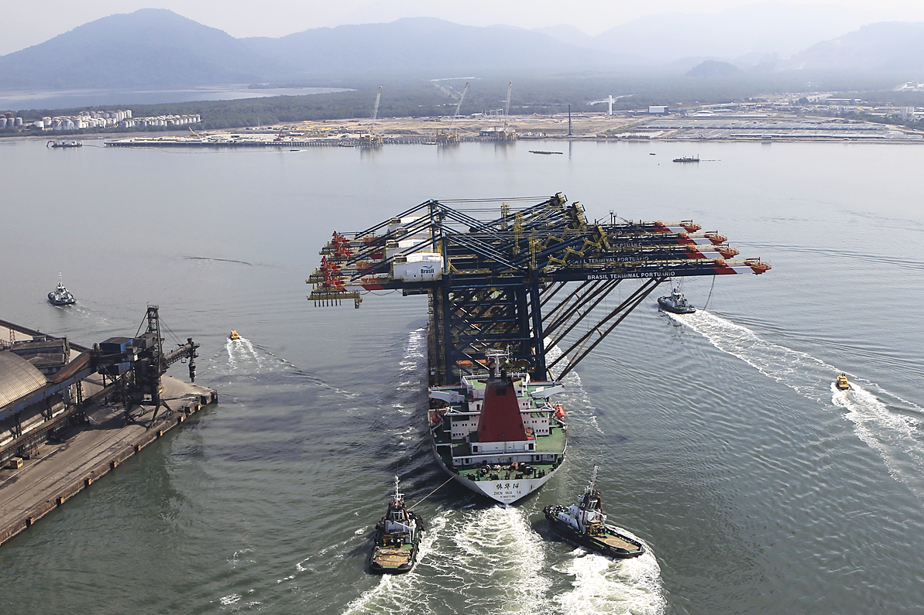
Towage
USD 178M
15.0%
52,204
Net Revenues
(28% of 2012 Total Revenues)
Special Operations
(% of 2012 Total Towage Revs)
Harbour Manoeuvres
(2012)
Special Operation (Arrival of equipment in the port of Santos)

Slide 13
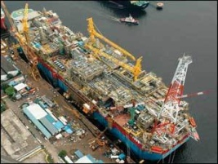
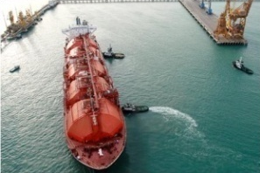
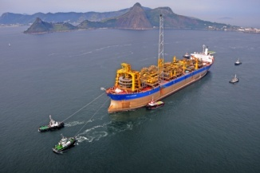
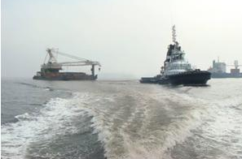
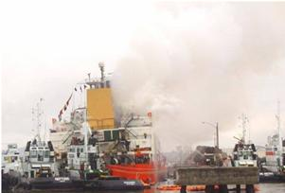
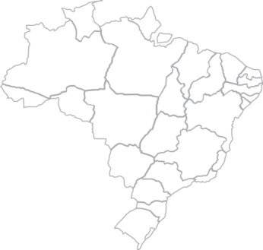
Towage
Largest fleet in Brazil, approx. 50% share at habour manouevres, operating in all major ports of Brazil
Regulatory protection ensures priority to Brazilian flag vessels (ANTAQ Resolution 494)
Friendly funding available from FMM (Fundo da Marinha Mercante) – Long-term, Low-cost
Special Operations
SUPPORT TO FPSO
CONSTRUCTION
LNG OPERATIONS
FPSO TOWAGE
OCEAN TOWAGE
SALVAGE
Revenues Breakdown
% of Total Towage Revenues
New Port Facilities
Source: BNDES + WS Estimates
USD 147.1 M
USD 145.7 M
USD 156.2 M
USD 167.4 M
USD 177.7 M
Refinery Premium I (MA)
Terminal Ponta da Madeira (MA)
Refinery Premium II (CE)
Refinery Abreu e Lima (PE)
Porto Sul (BA)
Porto do Açu (RJ)
Embraport (SP)
Brasil Terminais Portuários (SP)
Itapoá (SC)
Harbour Manoeuvres
85.7%
84.4%
85.0%
90.9%
84.8%
Special
Operations
15.6%
BRL ~R$ 54 Bi
in investments
9.1%
14.3%
15.2%
15.0%
2008
2009
2010
2011
2012

Slide 14
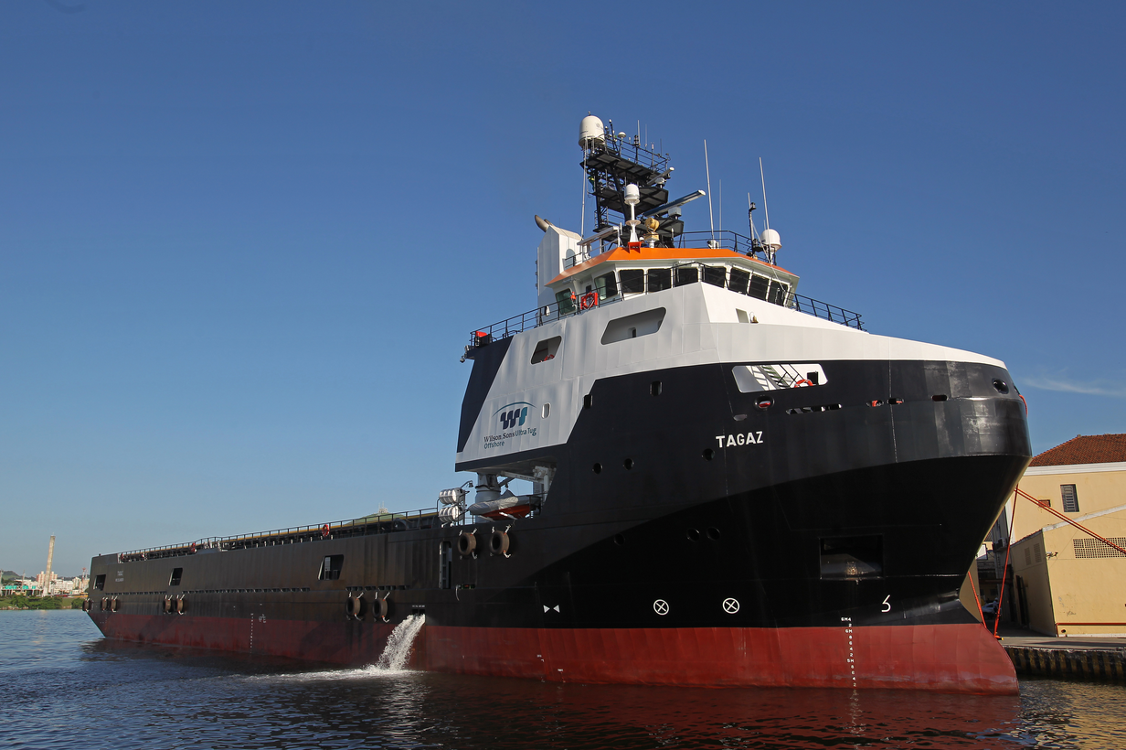
Offshore Vessels
USD 46M
18 OSVs
5,796
Net Revenues
(7% of 2012 Total Revenues)
15 owned PSVs + 3 flag cover AHTSs (as of Mar/13)
Days In Operation
(2012)
PSV Tagaz

Slide 15
Offshore Vessels
Regulatory protection ensures priority to Brazilian flag vessels (ANTAQ Resolution 495)
Friendly funding available from FMM (Fundo da Marinha Mercante) – Long-term, Low-cost
Wilson Sons 100%-owned shipyard is a key competitive advantage
Operational Fleet in Brazil (as of Nov/2012)
Source: ABEAM / SYNDARMA
Offshore FMM Financing Highlights (as of Dec/2012)
Source: Wilson Sons
PSV
AHTS
Others
Total
# Vessels currently financed
18
# Vessels with Undrawn Borrowing + Priority
9
Brazilian
81
19
88
188
Outstanding Debt Balance
USD 208 M
Undrawn Borrowing + Granted Priority
USD 232 M
Foreign
104
94
28
226
Duration of Current Contracts
9.2 yrs
Grace + Amortization Period
3 + 18 yrs
Foreign flag
Total
185
113
116
414
Brazilian flag
Cost of Debt of Current Contracts
3.7%
Average Cost of Debt
3.1%
Brazilian OSV Fleet Development
Source: ODS Petrodata + ABEAM / SYNDARMA + BTG Pactual
WSUT Fleet Development
Source: Wilson Sons
686
Brazilian Flag Vessels
30+
Foreign Flag Vessels
414
24
250
12
14
148
165
188
10
2010
2011
2012
2015
2017

Slide 16
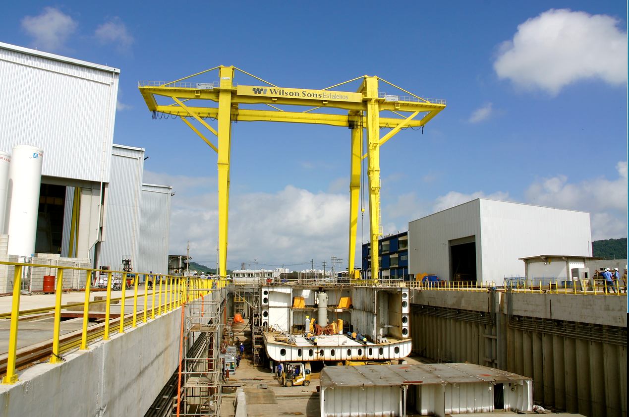
Shipyards
USD 62M
39
10,000
Net Revenues
(10% of 2012 Total Revenues)
Vessels Delivered
(2004 - 2012: 12 PSVs + 27 Tugboats)
Guarujá steel processing capacity (tons / yr)
Guarujá II Shipyard

Slide 17
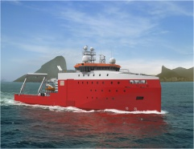
Shipyards
Providing great competitive advantage to the Company’s Towage and Offshore businesses
Friendly funding available from FMM (Fundo da Marinha Mercante) – Long-term, Low-cost
Construction plan for more than 50 vessels (Offshore and Tugboats) by 2017
Highlights
Tugboat Construction Plan
Guarujá I
Guarujá II
Total
Steel Processing Capacity (tons / year)
4,500
5,500
10,000
Area (sqm)
22,000
17,000
39,000
Dock type
Slipway
Dry-dock
n/a
Length (m)
150
135
n/a
Breadth (m)
16
26
n/a
OSV Construction Plan
Remotely Operated Vehicle
Support Vessel (ROVSV)

Slide 18
Financial Highlights

Slide 19
Resilience and growth
Net Revenues
USD M
Net Revenues by Business
USD M
698.0
2011
CAGR of 11.6%
645.3
203.5
2012
189.0
177.7
575.6
167.4
498.3
140.5
477.9
108.2
61.8
68.3
56.7
404.0
46.3
334.1
37.9
41.4
24.4
20.3
2006
2007
2008
2009
2010
2011
2012
Container Terminals
Brasco
Logistics
Towage
Offshore
Shipyard
Shipping Agency
EBITDA
USD M
EBITDA by Business
USD M (ex-Corporate)
163.3
151.5
2011
CAGR of 12.1%
128.4
74.6
2012
122.7
121.4
72.1
61.4
91.4
59.7
76.2
24.5
16.7
15.6
15.3
13.2
11.3
14.0
9.3
4.6
2.7
2006
2007
2008
2009
2010
2011
2012
Container Terminals
Brasco
Logistics
Towage
Offshore
Shipyard
Shipping Agency

Slide 20
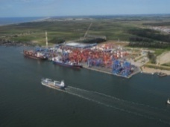
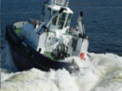
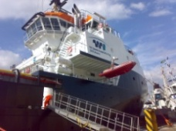

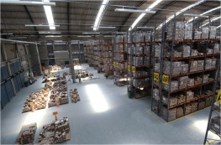

Consistent investment plan with low indebtedness
CAPEX Realised
Port Operation
Towage
Offshore
Shipyard
Others*
2006-2012
30%
28%
24%
7%
10%
USD 1.0 Billion
*Others: Logistics, Shipping Agency, and Corporate
Debt Maturity Schedule
(USD million)
Debt Profile
(as of Dec/12)
Weighted Avg. Cost of Debt
3.59% per year
CURRENCY
Denominated in USD
95%
Denominated in BRL
5%
MATURITY
Long Term
92%
Short Term
8%
SOURCE
FMM
75%
Others
25%
Debt Balance: 572 M ; Net Debt : 431 M
Net Debt / EBITDA = 2.8x

Slide 21
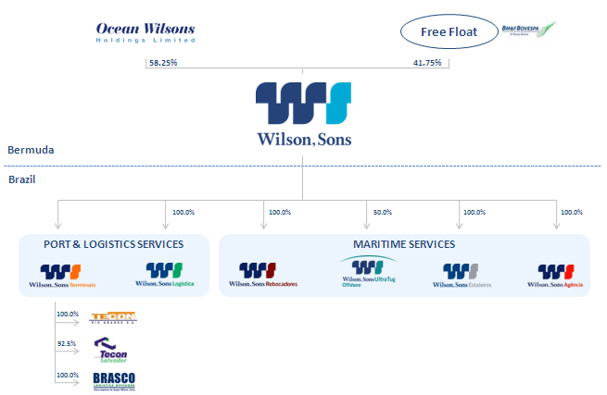

Corporate Governance: Voluntarily follow the majority of Novo Mercado rules
100% TAG ALONG for all minority shareholders
One class of share with equal voting rights
Free-float more than 25% of total capital
Audit Committee
Management alignment with
shareholders: Cash-settled Stock Options

Slide 22

Investor Relations Contact Info
Felipe Gutterres CFO of the Brazilian Subsidiary and Investor Relations ri@wilsonsons.com.br +55 (21) 2126-4112 | Michael Connell Investor Relations michael.connell@wilsonsons.com.br +55 (21) 2126-4107
BM&FBovespa: WSON11
IR website: www.wilsonsons.com/ir
Twitter: @WilsonSonsIR
Youtube Channel: WilsonSonsIR
Eduardo Valença Investor Relations eduardo.valenca@wilsonsons.com.br +55 (21) 2126-4105 | George Kassab Investor Relations george.kassab@wilsonsons.com.br +55 (21) 2126-4263
Nattalee Souza Investor Relations nattalee.souza@wilsonsons.com.br +55 (21) 2126-4293

